Slide 1
Flower Shop Management Website
Presented by
Jannatul Khould Neju
0562220005101014
Mithila Ishrat Khan
0562220005101047
Notes:
Hello everyone, I’m Mithila. I’m excited to present my project – a Flower Shop Management Website. This project is made for helping customers buy flowers online easily and helping shop owners manage their store smoothly.

Slide 2
Project Overview
Aim: Build a responsive online flower shop.
Purpose: Easy shopping for customers & smooth admin control
Notes:
The goal of this project was to create a website that works on mobile, tablet, and computer. It helps customers shop easily and allows admins to manage everything from their panel.

Slide 3

Technology Stack
Frontend: HTML, CSS (Flexbox & Grid), JavaScript
Backend: PHP
Database: MySQL
Security: Password authentication, input validation
Deployment: SSL-secured web hosting
Notes:
These are the technologies I used. The frontend was built using HTML, CSS, and JavaScript, and the backend was done in PHP with MySQL as the database. The site is hosted securely using SSL encryption.
SSL-Secure Sockets Layer--a security protocol that encrypts data between a user’s browser and a website.

Slide 4
Development Phases
Phrase | Task | Duration
1 | Requirements Gathering & Planning | 1 Week
2 | UI/UX Design | 2 Weeks
3 | Frontend Development | 2 Weeks
4 | Backend Development | 3 Weeks
6 | Testing & Debugging | 2 Weeks
7 | Deployment & Finalization | 1 Week
Notes:
For this project, we used the Waterfall Model. It follows a step-by-step process where each phase is completed before moving to the next one. This model is good for small projects with fixed requirements like ours

Slide 5
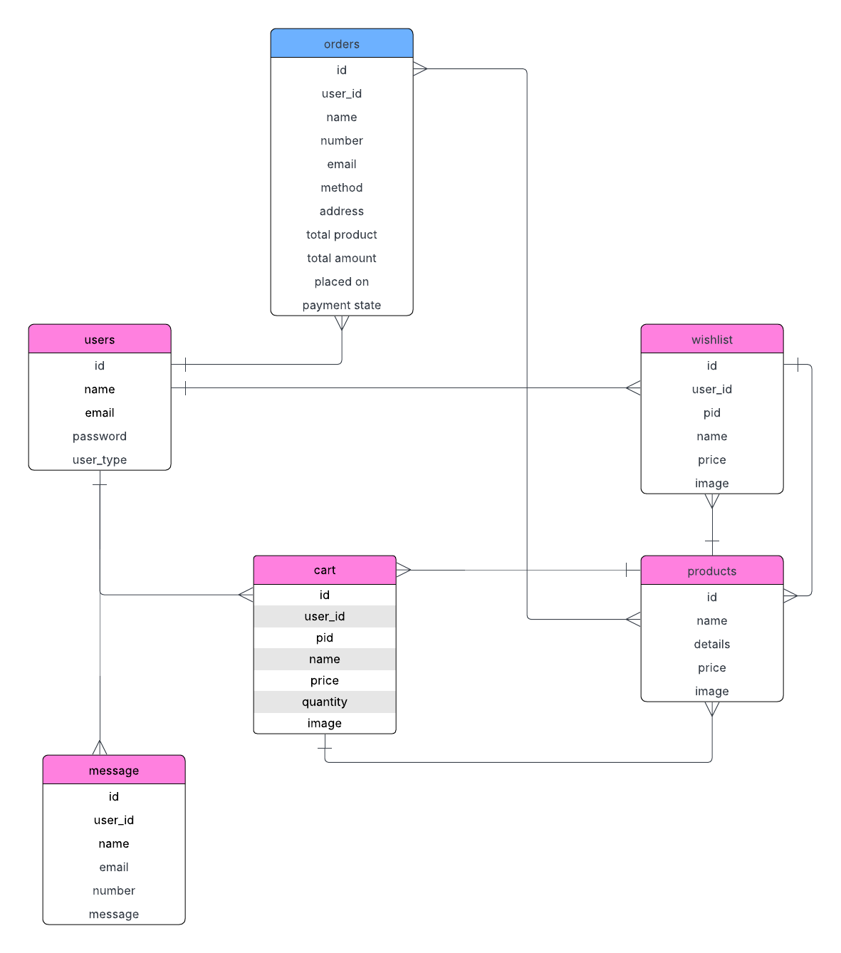
ER-DIAGRAM
Notes:
This is the ER-diagram of this project.

Slide 6
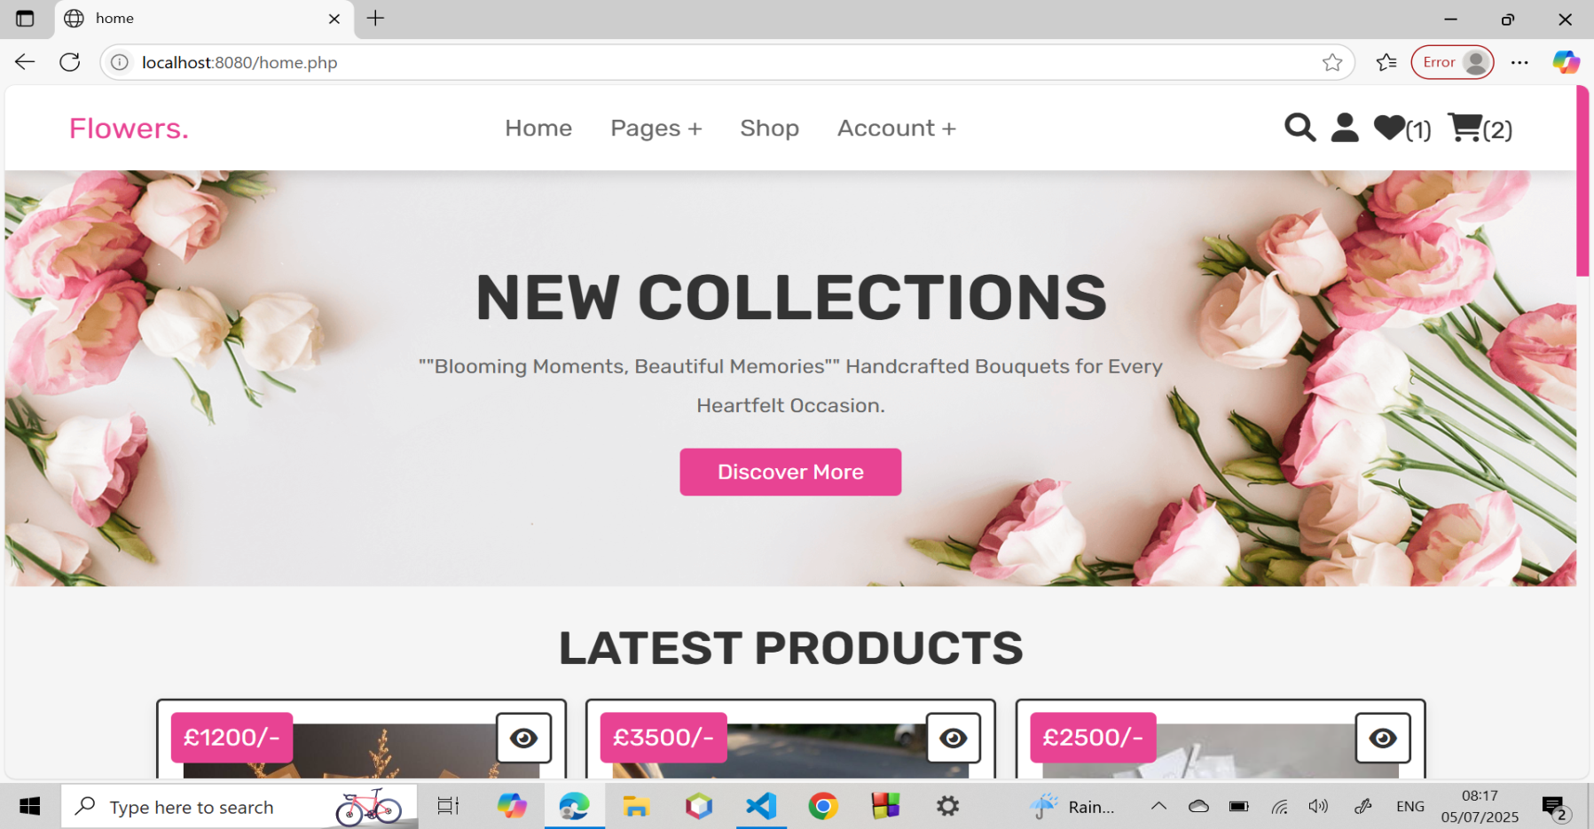
Home page
Notes:
This is the Home Page of our flower shop website. It shows beautiful flowers, a menu at the top. It is easy to use and looks nice on both mobile phones and computers. We made it simple so that customers feel happy and comfortable when they visit the site.

Slide 7
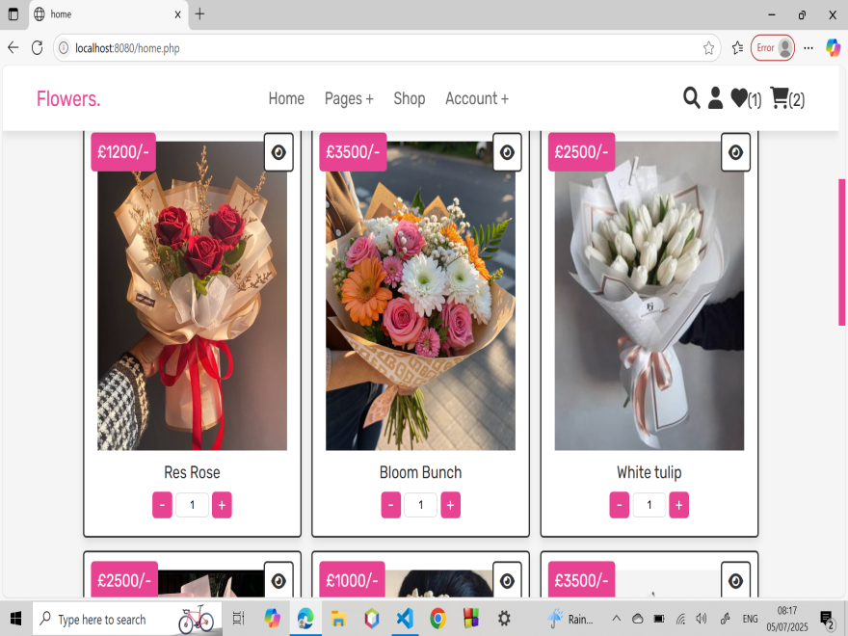
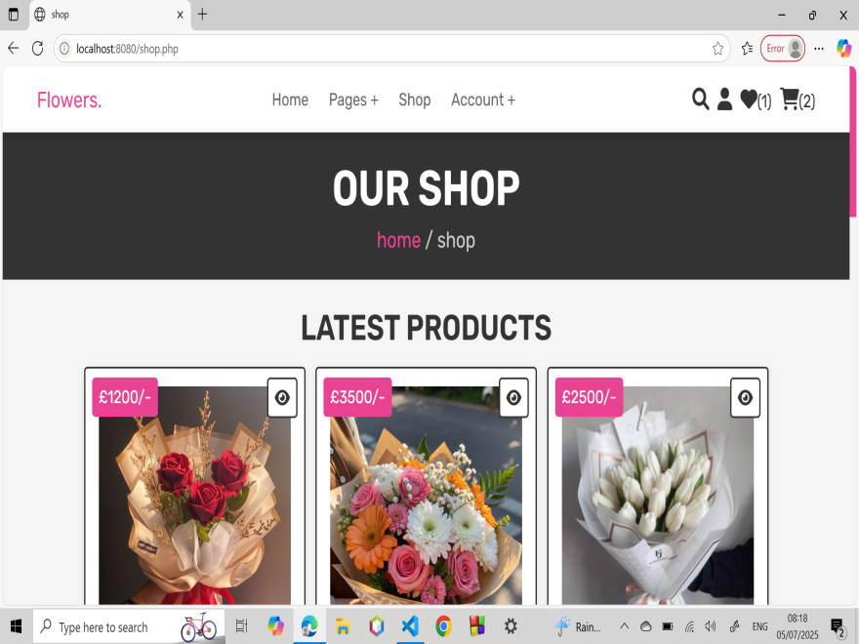
Customer Panel Features
Responsive homepage with flower highlights
Quick product view & detail page
Notes:
Here, users can see flower images, names, prices, and a “View Details” or “Add to Cart” button. Each product has a quick view option so users can get more info fast. It helps customers choose flowers easily.

Slide 8
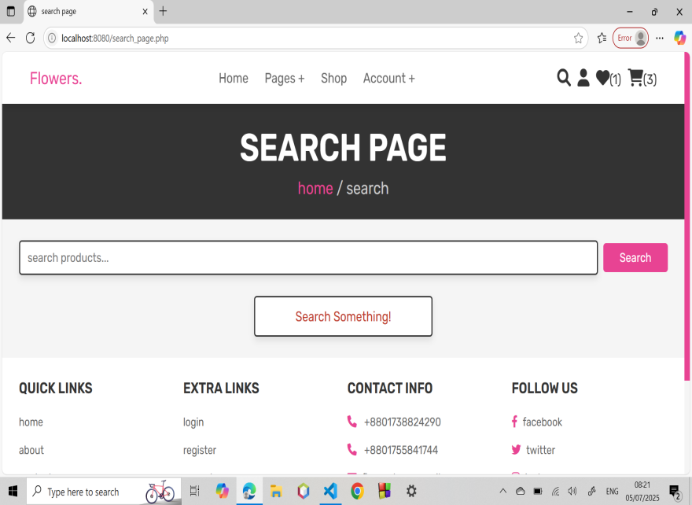
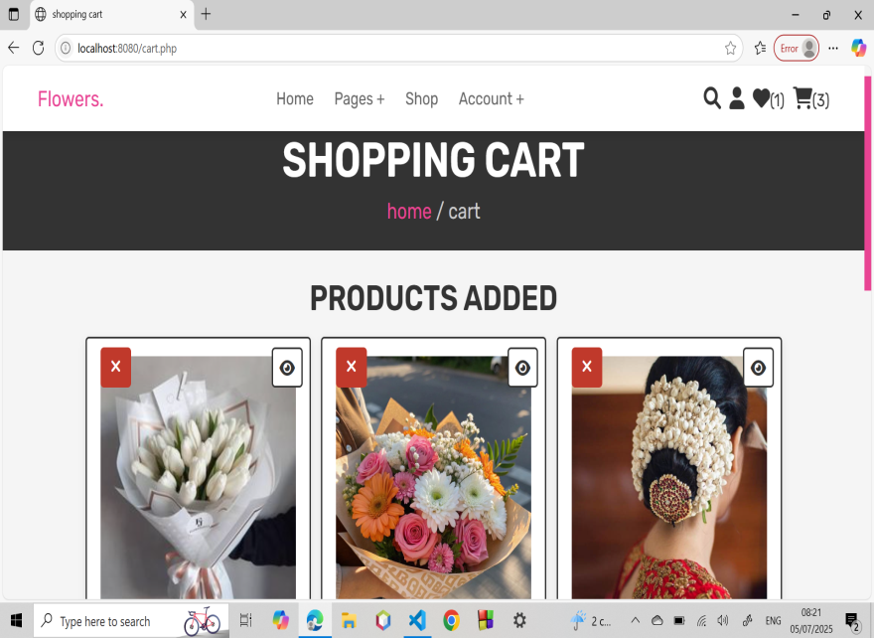
Customer Panel Features
Search bar
Add to cart & wishlist
Notes:
This is the Search Feature. Customers can type a flower name or keyword to find what they are looking for. The results show up quickly and clearly. It saves time and helps users find their favorite flowers without scrolling too much.
This is the Cart Page. It shows the products added by the customer, along with price, quantity, and total cost. Customers can also remove or update items from here before they checkout.

Slide 9
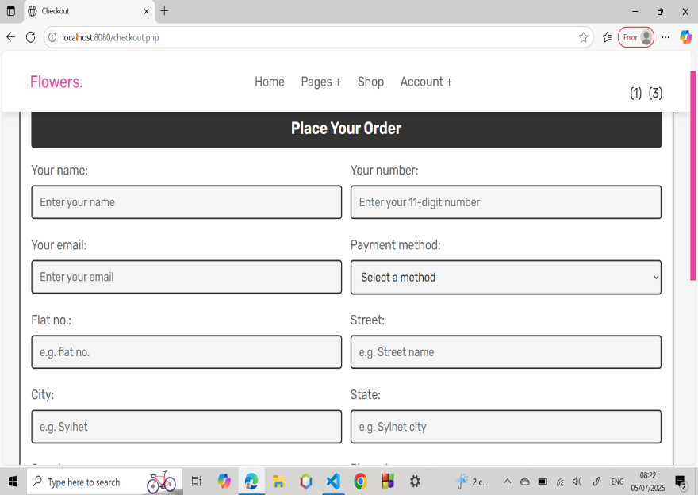
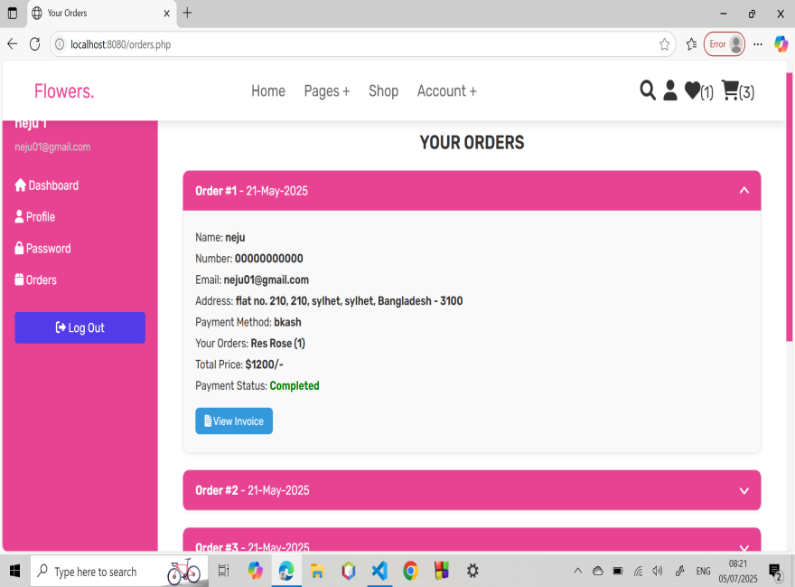
Customer Panel Features
Checkout page
Order confirmation
Notes:
This is the Checkout Page. Customers enter their name, address, phone number, and choose a payment method. We also added form validation to make sure the data is correct. This page is secure and simple to complete an order.
After checkout, customers see this Order Confirmation Page. It shows a thank you message, order ID, and a summary of what they ordered. It helps users feel confident that their order was placed successfully.

Slide 10
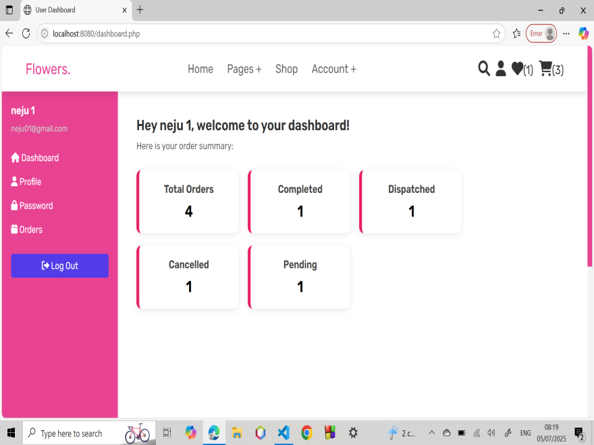
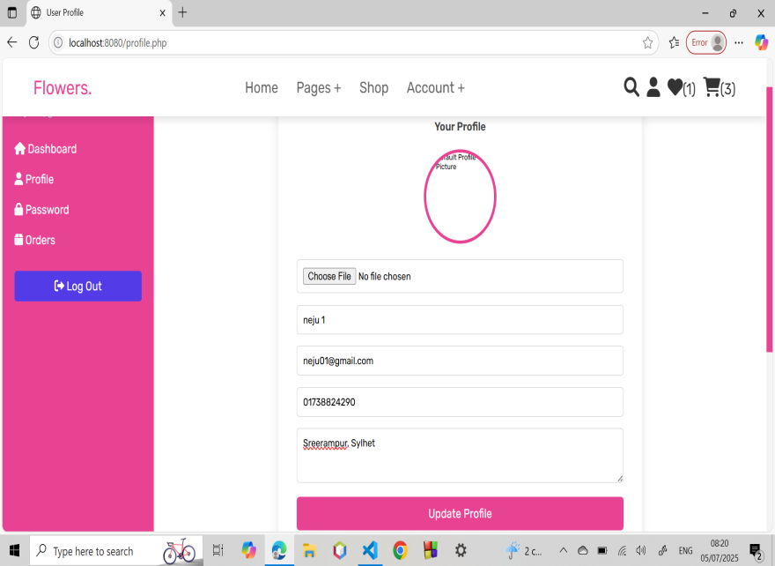
Customer Panel Features
Account creation page
Customer profile
Notes:
This is the Customer Account Creation or Profile Page. It allows users to create an account by signing up with their name, email, and password. After logging in, they can view and edit their personal information like address and contact details. It also shows their order history, which helps in easy tracking and reordering.

Slide 11
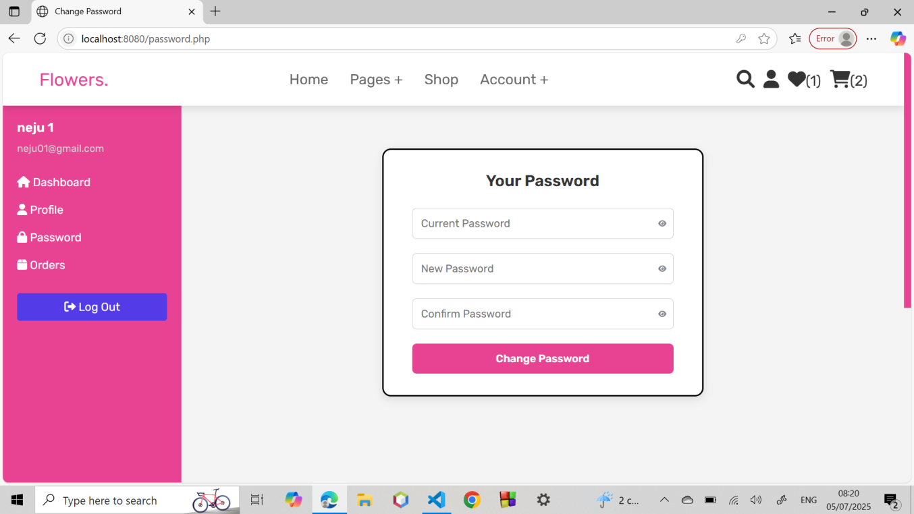
Customer Panel Features
Notes:
This is the Password Reset Page. If a user forgets their password, they can enter their email here to get a reset link. It helps users log in again safely without losing their account. This feature improves user experience and security.

Slide 12
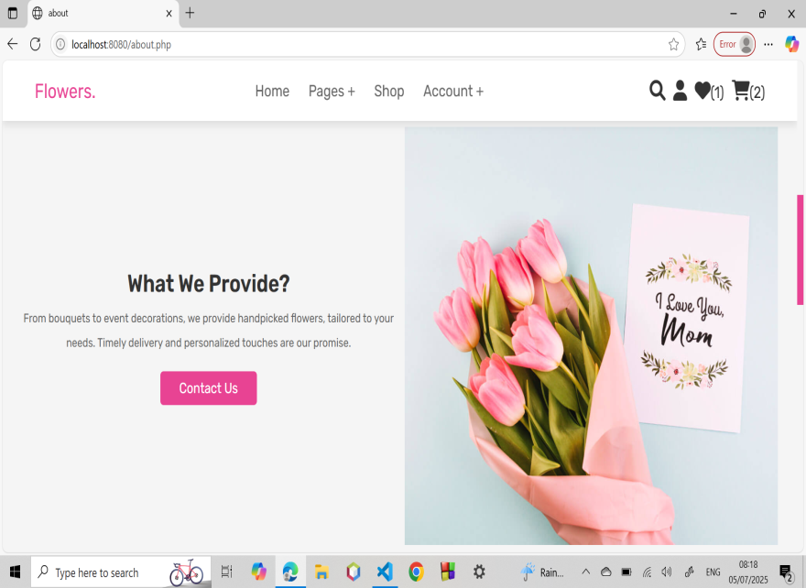
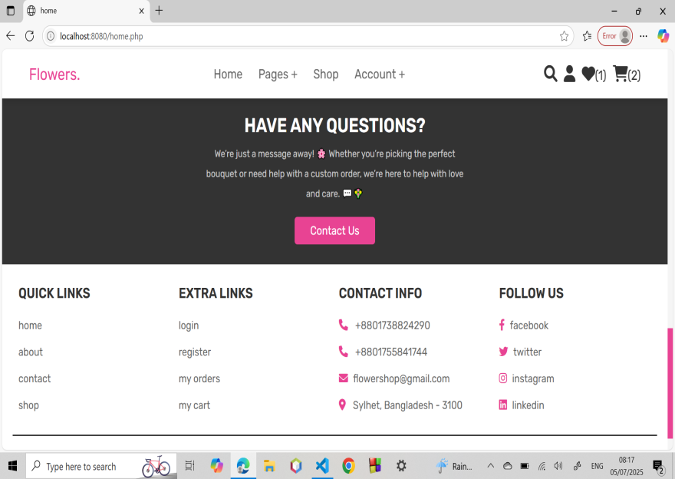
Customer Panel Features
About us
Footer
Notes:
We added a short description about our mission, quality service, and our commitment to fresh flowers. This helps build trust with new users and makes the website feel more personal and professional.
This is the Footer section of the website. It appears on every page, at the bottom. We added important links like About Us, Contact, Privacy Policy, and Social Media. It also includes the shop address, phone number, and email.

Slide 13
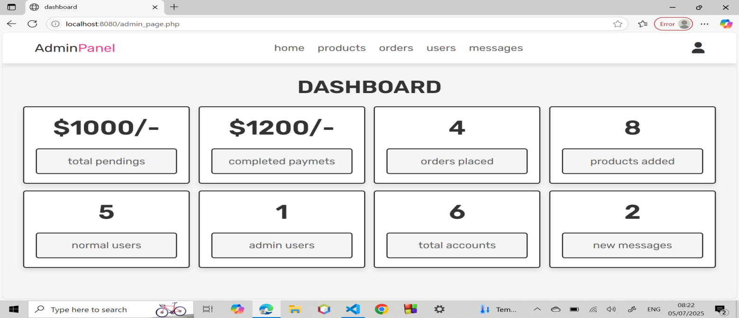
Admin Dashboard Features
Admin dashboard:
A control panel for the admin.
Shows important data in one place.
Helps manage users, content, and system settings.
Notes:
This is the Admin Dashboard. Admins can manage products, orders, users, and see sales reports from here. It’s easy to use and helps shop owners handle everything from one place.
Admins can Create, Read, Update, and Delete products. They can also change product prices, photos, and stock easily

Slide 14
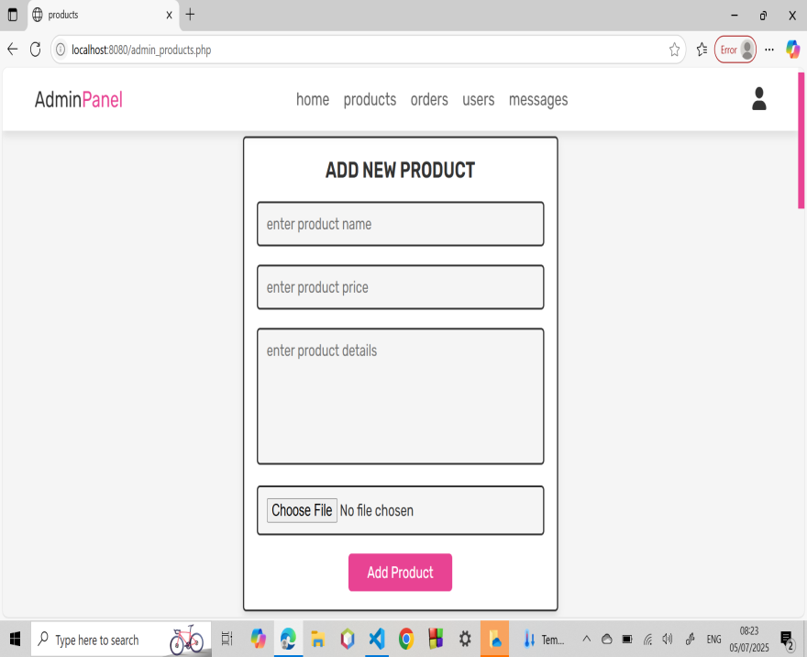
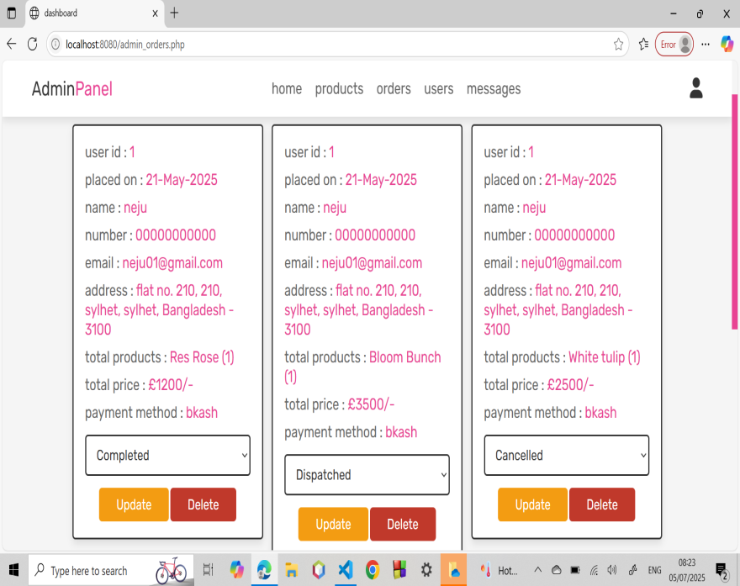
Admin Dashboard Features
Add product
Order details
Notes:
All customer orders are shown here. Admins can check order status, mark it as delivered, or even cancel orders if needed.
Admins can manage roles like customer, staff, or admin. This helps control what each user can see and do.

Slide 15
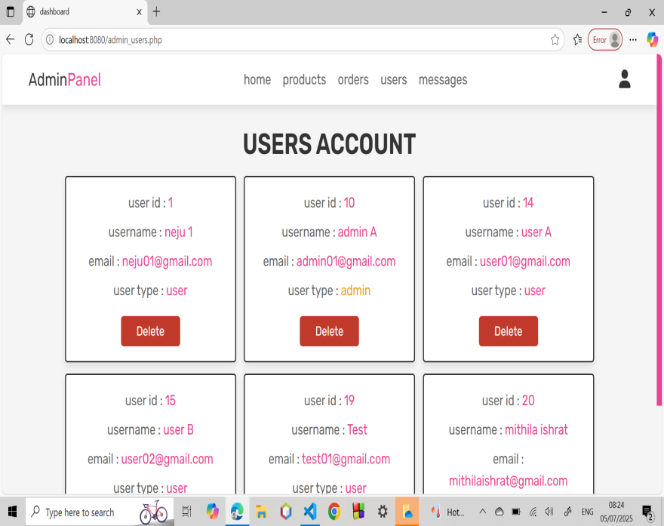
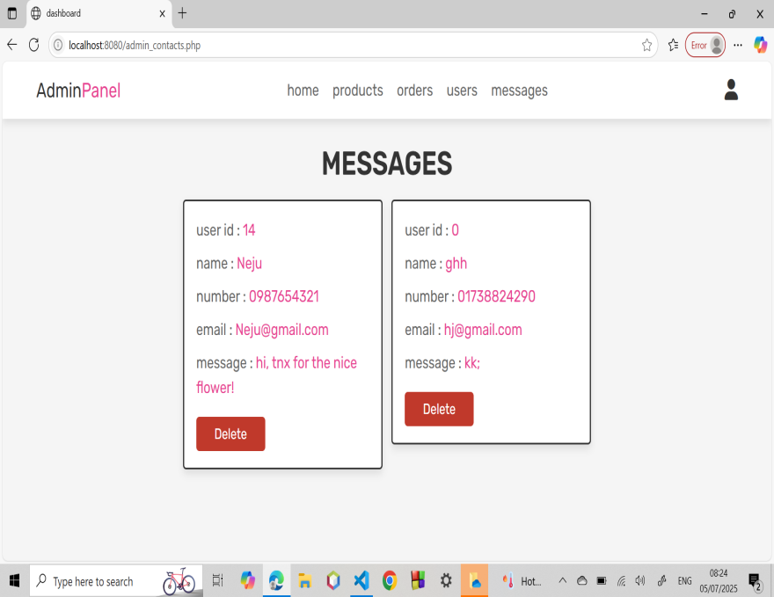
Admin Dashboard Features
User accounts
Customers messages
Notes:
Admins can view and manage all registered user accounts. They can see user details, account activity, or even delete or block accounts if needed.
All messages from the contact form are shown here. Admins can read and reply directly to customers.

Slide 16
Challenges We Faced
Making the Customer Profile Page was the hardest part.
It was tricky to let users change their info and keep the page working well on phones and computers.
Making sure the website looked good and worked on all screen sizes.
Handling login, logout, and keeping users logged in correctly.
Connecting all parts like cart, orders, and products without errors.
Not enough time to add extra features like a mobile app or live chat.

Slide 17
What We Learned
How to build a full website using PHP, MySQL, HTML, CSS, and JavaScript.
How to let users register, log in, and manage their accounts.
How to show and update products, orders, and messages.
How to make a website easy to use and responsive.
How to plan a project, fix problems, and finish everything on time.

Slide 18
Conclusion
A complete system for online flower shop
Works smoothly on all devices
Helps both customers and admins
Successfully done with extra features
Notes:
This is a complete flower shop website. It works well for customers and is easy to manage for admins. It’s responsive, secure, and works well. I’m happy with how it turned out.

Slide 19
THANK YOU
Notes:
That’s all about our project,thank you

